Slide 1

Docker for AI Engineers
Package & Share Your AI Projects Like a Pro
Containerize FastAPI & Streamlit apps — run anywhere, identically
A Hands-On 3-Hour Workshop

Slide 2



Know Your Instructor
Varush H.
Senior Data Scientist · PwC India
Senior Data Scientist @ PwC India
Leads high-impact AI/ML projects delivering measurable business ROI across enterprise clients in consulting.
Agentic & Generative AI Practitioner
Architected and shipped production-grade Agentic AI, NLP, Deep Learning, and LLM-powered solutions.
Scan to Connect on
Student Mentor & Educator
Mentors aspiring data scientists and junior engineers — guiding careers, projects, and skill-building in AI/ML.
Workshop Facilitator — AI
Delivers hands-on workshops translating complex AI concepts into practical, build-ready knowledge for learners.

Slide 3




Where You Are & Where You're Going
So Far
After Today
You built a LangChain agent, wrapped it in a FastAPI app, and ran it with Uvicorn — on YOUR machine, with YOUR setup.
Your app is packaged in a container — a single unit anyone can run on any machine with one command, no setup headaches.
Today's Outcome
You can package and share any AI project professionally — so it runs identically on a laptop, a server, or the cloud.

Slide 4
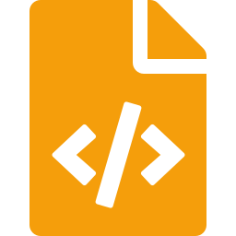

Session Agenda — 3-Hour Roadmap
Hour 1
What is Docker (Practical)
The 'works on my machine' problem, containers vs VMs, key concepts, and why Docker matters for AI
Hour 2
Dockerfiles for AI Apps
Writing a Dockerfile, building images, .dockerignore, best practices & handling secrets
Hour 3
Containerize & Run
Containerize your FastAPI & Streamlit apps, run them locally, and share via Docker Hub

Slide 5
Hour 1: What is Docker?
The practical mental model — no theory overload
60 min

Slide 6



How We Got Here: The Evolution of Running Apps
Each leap was invented to fix the pain of the one before it. Smaller, faster, more portable every time.
ERA 1
ERA 2
ERA 3
Physical Servers
Virtual Machines
Containers
~1990s–2000s
~2000s
~2013 → today
One app, one whole machine
Many virtual computers in one box
Share the OS, ship just the app
Let's walk each era — what it was, why it hurt, and the breakthrough it forced.
Notes:
"Before we touch Docker, let's understand why containers even exist. Every one of these three eras was invented to fix a real pain in the one before it. Notice the trend as we move left to right — smaller, faster, more portable each time. Keep that arrow in mind."
Era 1 — Physical Servers (point to the red card)
"We start in the 1990s–2000s. Back then, the rule was basically one app, one whole machine. If your company needed a website and an email system, that's two separate physical servers humming in a room. It worked — but imagine buying an entire house just to use one room. Most of that expensive machine sat idle. That waste is the pain that pushed us to the next idea."
The first arrow — make it a question
"So engineers asked: can we safely run several apps on one machine? That question gives us Era 2."
Era 2 — Virtual Machines (point to the amber card)
"Around the 2000s we get virtual machines — many virtual computers inside one box. One physical server gets sliced into several independent machines. Think of turning that one house into separate apartments — now multiple tenants share the building. Much less waste. But there's a catch we'll see in a minute: every apartment still has its own full kitchen and plumbing. Hold that thought."
The second arrow
"That catch is what makes VMs heavy — and heaviness is the pain that leads to Era 3."
Era 3 — Containers (point to the blue Docker card)
"From about 2013 to today: containers. The key phrase is share the OS, ship just the app. Instead of each app carrying its own full operating system, they all share one — and you package only your app and its dependencies. It's like co-living: private rooms, but shared plumbing and power. Lightweight, fast, and it's exactly what Docker gives us."
Close with the footer
"So here's our plan" — point to the dark bar — "we'll walk each era one at a time: what it was, why it hurt, and the breakthrough that pain forced. By the end you'll understand not just what Docker is, but why it had to be invented."

Slide 7



Era 1: Physical Servers — One App, a Whole Machine
What It Was
Why It Became Painful
Each app ran on its own dedicated, bare-metal server. Want to run another app safely? Buy another machine.
Expensive
A whole server for a single app
Wasteful
Apps used only ~10–15% of capacity
The Analogy
Slow to set up
Order, ship & rack hardware — weeks
Like buying an entire house just to use one room. Most of it sits empty — but you pay for, power, and maintain all of it.
Hard to scale
Need more power? Buy another box
Risky to share
Two apps on one server can clash
The fix: slice one physical server into many isolated machines — the Virtual Machine.

Slide 8



Era 2: Virtual Machines — Many Computers in One
What It Was
The Wins Over Physical
A hypervisor splits one physical server into several Virtual Machines — each a full computer with its own operating system.
Many VMs per server — far less waste
Strong isolation between VMs
Minutes to create, not weeks
But Still Painful
The Analogy
Heavy
Each VM ships a full OS — many GBs
An apartment building: one structure split into self-contained units. Better — but every apartment still has its OWN full kitchen & plumbing (its own OS).
Slow to boot
Booting a whole OS takes minutes
Duplicated
overhead
Every VM re-runs its own OS
Low density
Only a handful of VMs per server
The fix: let apps SHARE one OS instead of each carrying its own — the Container.

Slide 9

Era 3: Containers — Share the OS, Ship Just the App
What It Is
Why It Won
Containers share the host's operating system and package only the app + its dependencies — no full guest OS per app.
Lightweight
Just app + deps — tens of MBs
Fast
Starts in seconds, not minutes
The Analogy
Dense
Run many on a single machine
Co-living PGs: private rooms, but everyone shares the building's core plumbing & power (the host OS). No duplicate kitchens — so units are tiny and instant to move into.
Portable
Runs identically anywhere
Isolated
Each container is sandboxed
This is exactly what Docker delivers — let's see how it works.

Slide 10
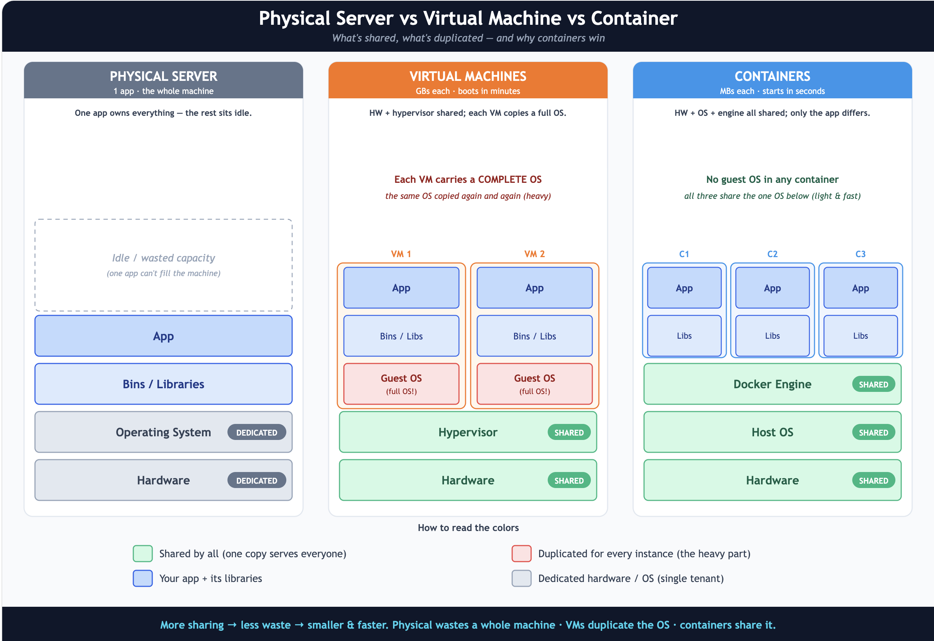
Physical vs VM vs Container — At a Glance

Slide 11
Physical vs VM vs Container — At a Glance
Aspect | Physical Server | Virtual Machine | Container
Isolation unit | The whole machine | A full OS per VM | Just the app + deps
Startup time | Minutes to hours | Minutes | Seconds
Size | An entire server | Many GBs each | Tens of MBs
Density per host | 1 app | A few VMs | Many containers
Resource overhead | Very high | High (full OS each) | Low (shares kernel)
Portability | Tied to hardware | Tied to hypervisor | Runs anywhere
Same direction every time: lighter, faster, and more portable. Containers are today's sweet spot.

Slide 12

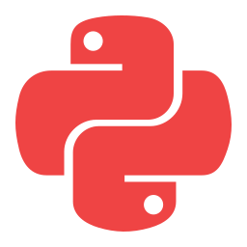
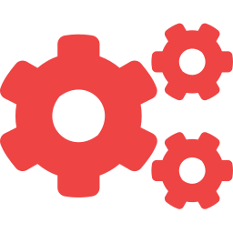



The Problem: "But It Works on My Machine!"
You build an AI app that runs perfectly on your laptop. You send it to a teammate or deploy it to a server — and it breaks. Sound familiar?
Why It Breaks Elsewhere
Different Python version
Missing system libraries
Dependency conflicts
No GPU / CUDA drivers
Different OS (Mac vs Linux)
Forgotten env variables
Docker eliminates ALL of these by packaging the app WITH its entire environment.

Slide 13

What is Docker? The Shipping Container Idea
Before Containers (Shipping)
After: The Standard Container
Goods were loaded loose & by hand — barrels, sacks, crates of every shape. Slow, chaotic, and nothing fit neatly on different ships or trucks.
One standard box. It fits any ship, crane, or truck — the same way, every time. The contents don't matter; the box is standard.
= Software with messy, manual setup on every machine
= Your app + ALL its dependencies in one standard unit that runs identically anywhere

Slide 14
Containers vs Virtual Machines
Virtual Machine
Container (Docker)
App A | App B
App A | App B | App C
Guest OS | Guest OS
Docker Engine
Hypervisor
Host Operating System
Host Operating System
Physical Hardware
Physical Hardware
Light (MBs) · fast start (seconds) · shares the host kernel
Heavy (GBs) · slow start (minutes)
Containers skip the heavy guest OS — that's why they're smaller and start in seconds.

Slide 15
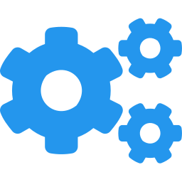
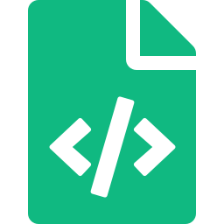


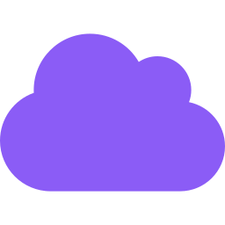
The 5 Words You Need to Know
Docker Engine
The runtime that does the work — the program on your machine that builds images and runs containers.
Dockerfile
The recipe — a text file of instructions that tells Docker how to build your image.
Image
The blueprint — a read-only template with your app + all it needs. Like a class in code.
Container
A running instance of an image. Like an object from a class — run many from one image.
Registry
Where images are stored & shared (e.g. Docker Hub). Push yours up; pull others down.

Slide 16


How Docker Works: Build → Ship → Run
docker build
Docker
run
Dockerfile
Image
Container
your recipe
built blueprint
running app
docker push / pull
Registry (Docker Hub)
push to share · pull to reuse

Slide 17



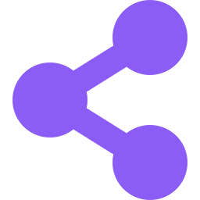


Why Docker Matters for AI Engineers
Tame Heavy Dependencies
Perfect Reproducibility
GPU Support
torch, transformers, CUDA — pin the exact versions once, never fight install errors again.
The same environment from your laptop to production. Kills 'works on my machine' forever.
Run GPU-accelerated models in containers with the NVIDIA Container Toolkit.
Effortless Sharing
Clean Isolation
Cloud & Scale Ready
Ship your model + code as one image. Teammates run it with a single command.
Different projects need different versions? Each container is its own sealed world.
Containers are the unit cloud platforms & Kubernetes deploy and scale.

Slide 18
Installing & Verifying Docker
Install Docker
Verify It Works
Mac / Windows
Docker Desktop (GUI + engine)
Run these two commands. If both succeed, you're ready:
Linux
Docker Engine (apt / dnf)
docker --version
docker run hello-world
Check it's running
Docker Desktop whale icon in tray
What 'hello-world' proves
Running `docker run hello-world` makes Docker pull a tiny image from the registry, create a container from it, and run it — proving the whole build-ship-run pipeline works on your machine. It's the Docker equivalent of 'Hello, World!'.

Slide 19

Hour 2: Dockerfiles for AI Apps
Write the recipe, build the image
60 min

Slide 20





What is a Dockerfile? It's a Recipe
A Dockerfile is a plain text file with step-by-step instructions to build your image. Think of it as a recipe: each line is one step, run in order, top to bottom.
Start with base ingredients
FROM — pick a base image
Set up your kitchen counter
WORKDIR — set the work folder
Add your ingredients
COPY — copy files into the image
Cook / prepare
RUN — install dependencies
Serve the dish
CMD — the command to start the app

Slide 21
The Core Dockerfile Instructions
FROM
The base image to build on (e.g. python:3.11-slim)
WORKDIR
Set the working directory inside the container
COPY
Copy files from your project into the image
RUN
Execute a command at BUILD time (install deps)
ENV
Set an environment variable
EXPOSE
Document which port the app listens on
CMD
The default command to run when the container STARTS
RUN happens once at BUILD time. CMD happens every time the container STARTS — a key distinction.

Slide 22

Your First Dockerfile
# Dockerfile
# 1. Start from a base image with Python
FROM python:3.11-slim
# 2. Set the working directory in the image
WORKDIR /app
# 3. Copy & install dependencies
COPY requirements.txt .
RUN pip install -r requirements.txt
# 4. Copy the rest of the app
COPY . .
# 5. Command to run when it starts
CMD ["python", "main.py"]
Read It Top to Bottom
Each line is one build step
Docker runs them in order
Each step creates a cached 'layer'
The result is your image
That's a complete, working image definition in 6 instructions.
Why copy requirements.txt BEFORE the rest of the code? Layer caching — more on the next slides.

Slide 23
Dockerfile for Your FastAPI AI App
# Dockerfile for the FastAPI agent app
FROM python:3.11-slim
WORKDIR /app
# Install deps FIRST (cached unless requirements change)
COPY requirements.txt .
RUN pip install --no-cache-dir -r requirements.txt
# Copy the application code
COPY . .
# Document the port Uvicorn listens on
EXPOSE 8000
# Start the API with Uvicorn, bound to all interfaces
CMD ["uvicorn", "system.main:app", \
"--host", "0.0.0.0", "--port", "8000"]
AI-App Specifics
--host 0.0.0.0
Without this, the API only listens inside the container & is unreachable.
--no-cache-dir
Skips pip's cache to keep the image smaller.
EXPOSE 8000
Documents the port (you still map it at run time).
requirements first
Deps re-install only when requirements.txt changes.

Slide 24
Building the Image
docker build -t my-agent-api .
Decoding the command
docker build = build an image · -t my-agent-api = name (tag) it · . = build context (this folder)
Then see your image:
$ docker images
REPOSITORY TAG IMAGE ID SIZE
my-agent-api latest a1b2c3d4e5f6 210MB
# Docker builds each Dockerfile line as a cached LAYER.
# Change only your code? Only the COPY layer rebuilds — fast.

Slide 25
Keep Junk Out with .dockerignore
Why It Matters
# .dockerignore
.env
venv/
.venv/
__pycache__/
*.pyc
.git/
.gitignore
*.md
.pytest_cache/
data/ # large local data
*.log
Like .gitignore, a .dockerignore file tells Docker which files to leave OUT of the image. This makes builds:
Smaller
no venv, caches, or data bloat
Faster
less to copy into the image
Safer
your .env secrets never get baked in

Slide 26



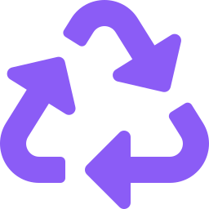

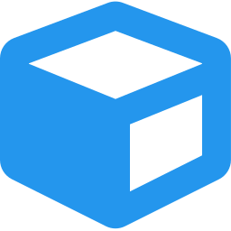
Best Practices for AI Dockerfiles
Use slim, pinned base
Deps before code
Keep images small
python:3.11-slim, not python:latest. Smaller & reproducible.
COPY requirements first so the install layer caches between builds.
--no-cache-dir, remove build tools, clean up apt caches.
Multi-stage builds
Run as non-root
One process per container
Build heavy deps in one stage, copy only what's needed to the final image.
Create a user; don't run the container as root for security.
API in one, frontend in another — compose them together.

Slide 27
Handling Secrets & Environment Variables
NEVER bake API keys into the image! Anyone who pulls your image can extract them. Hard-coding OPENAI_API_KEY in the Dockerfile is a serious security leak.
Pass secrets at RUN time instead:
# Option A — pass a single variable
docker run -e OPENAI_API_KEY=sk-... <image_name>
# Option B — pass a whole .env file (recommended for dev)
docker run --env-file .env <image_name>
In production:
use your cloud's secret manager (AWS Secrets Manager, etc.) — never plaintext files. The image stays clean and shareable; secrets are injected only at run time.

Slide 28

Hour 3: Containerize & Run
Package your real apps and ship them
60 min

Slide 29
Containerize Your FastAPI Agent (Last Session)
Take the layered agent-fastapi project and add two files at the root:
agent-fastapi/
├── domain/
├── generator/
├── service/
├── controllers/
├── system/
├── requirements.txt
├── Dockerfile <-- NEW
└── .dockerignore <-- NEW
Three Steps to Ship It
1
Add the Dockerfile
(the FastAPI one from Hour 2)
2
Add .dockerignore
(exclude .env, venv, caches)
3
Build the image
docker build -t agent-api .
The entire layered app — Controller, Service, Generator, Domain, System — now lives in ONE portable image.

Slide 30
Running the Container
docker run -d -p 8000:8000 --env-file .env --name agent agent-api
Flag by flag
-d
Detached — run in the background
-p 8000:8000
Map host port 8000 → container port 8000
--env-file .env
Inject secrets at run time (never baked in)
--name agent
Give the container a friendly name
It's live!
The port mapping is the magic: your browser hits localhost:8000 and Docker forwards it into the container.
Open http://localhost:8000/docs — your agent API is running in a container.

Slide 31
Containerizing a Streamlit App
Same pattern — only the base command changes. Streamlit defaults to port 8501:
# Dockerfile for a Streamlit app
FROM python:3.11-slim
WORKDIR /app
COPY requirements.txt .
RUN pip install --no-cache-dir -r requirements.txt
COPY . .
EXPOSE 8501
# Bind to 0.0.0.0 so it's reachable outside
CMD ["streamlit", "run", "app.py", \
"--server.address=0.0.0.0", \
"--server.port=8501"]
Build & Run
docker build \
-t my-chat-ui .
docker run -p \
8501:8501 \
my-chat-ui
Then open:
localhost:8501
Key difference: the CMD runs `streamlit run` and binds the address so the UI is reachable from your browser.

Slide 32
Essential Docker Commands Cheat Sheet
docker build -t name .
docker run -p 8000:8000 name
Build an image from a Dockerfile
Create & start a container
docker ps
docker ps -a
List running containers
List ALL containers (incl. stopped)
docker logs <id>
docker exec -it <id> bash
View a container's output
Open a shell inside a running container
docker stop <id>
docker rm <id>
Stop a running container
Remove a container
docker images
docker rmi <image>
List local images
Remove an image

Slide 33
Docker Compose — Multi-Container Apps
Why Compose?
# docker-compose.yml
services:
api:
build: ./agent-fastapi
ports:
- "8000:8000"
env_file:
- .env
frontend:
build: ./streamlit-ui
ports:
- "8501:8501"
depends_on:
- api
Real apps have multiple containers — e.g. a FastAPI backend AND a Streamlit frontend, or an app PLUS a vector database.
Compose defines them all in ONE YAML file and starts everything with ONE command:
docker compose up

Slide 34
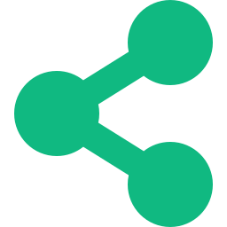
Sharing Your Image via Docker Hub
1
Tag it
2
Log in
3
Push it up
docker tag agent-api
yourname/agent-api:1.0
docker login
docker push
yourname/agent-api:1.0
Now anyone, anywhere, runs your AI app with ONE command:
docker run -p 8000:8000 --env-file .env yourname/agent-api:1.0

Slide 35
Hands-On Exercise: Ship Your Agent
Containerize the FastAPI agent API you built last session and run it — fully in Docker, with no local Python needed.
1
Write the Dockerfile
2
Add .dockerignore
FROM python:3.11-slim, install deps, EXPOSE 8000, CMD uvicorn
Exclude .env, venv/, __pycache__, .git
3
Build the image
4
Run with secrets
docker build -t agent-api .
docker run -p 8000:8000 --env-file .env agent-api
5
Test it live
6
Bonus: push it
Open localhost:8000/docs and call /chat
Tag & push to your Docker Hub account

Slide 36
Common Pitfalls & How to Avoid Them
Pitfall | Fix
API runs but browser can't reach it | Bind to --host 0.0.0.0, not 127.0.0.1
Forgot to map the port | Add -p 8000:8000 to docker run
Baked secrets into the image | Pass at run time via --env-file or -e
Huge multi-GB image | Use a -slim base + .dockerignore + --no-cache-dir
Every build re-installs deps slowly | COPY requirements.txt before the rest of the code
Changes don't show up | Rebuild the image; containers don't auto-update

Slide 37
Key Takeaways
1
Docker packages your app + its entire environment into one portable image — no more 'works on my machine'
2
Image = blueprint, Container = running instance, Dockerfile = recipe, Registry = where you share them
3
A Dockerfile reads top to bottom: FROM, WORKDIR, COPY, RUN, EXPOSE, CMD
4
Copy requirements before code, use slim bases, and add a .dockerignore to keep images small & fast
5
Never bake secrets into the image — pass them at run time with --env-file or -e
6
docker build → docker run -p → share via docker push. Anyone can then run your app with one command

Slide 38

Resources & Next Steps
Learning Resources
What to Explore Next
Docker Docs — docs.docker.com
Multi-stage builds for smaller images
Docker Hub — hub.docker.com
Docker Compose for API + frontend + DB
Play with Docker — labs.play-with-docker.com
GPU containers for local LLM inference
Dockerfile reference & best practices
Deploy to Render, Railway, or Fly.io
NVIDIA Container Toolkit (for GPUs)
Kubernetes — orchestrate at scale

Slide 39
You Can Ship It!
You can now package & share any AI project professionally
Questions & Discussion
Build once, run anywhere. That's the power of Docker.

